Slide 1
Digital Portfolio
STUDENT NAME: E.KARTHICK
REGISTER NO AND NMID: 222404341/B419723D8604537984F4E832C7CFC315
Department: BSC COMPUTER SCIENCE
COLLEGE: COLLEGE/ UNIVERSITY : A M Jain college, Meenambakkam
Notes:
R.Dharshini

Slide 2
PROJECT TITLE
HTML FRAMES

Slide 3


AGENDA
Problem Statement
Project Overview
End Users
Tools and Technologies
Portfolio design and Layout
Features and Functionality
Results and Screenshots
Conclusion
Github Link
3/21/2024 Annual Review

Slide 4

PROBLEM STATEMENT
Problem Statement:
HTML FramesCreate a webpage using HTML frames that divides the browser window into:A header frame at the top,A navigation frame on the left, andA main content frame on the right.The navigation frame should contain links (Home, About, Courses, Contact) that load the corresponding pages in the main content frame. Add a <noframes> section for browsers that do not support frames.

Slide 5

PROJECT OVERVIEW
<!-- index.html --><!DOCTYPE html><html><head> <title>HTML Frames Example</title></head><frameset rows="20%,80%"> <frame src="header.html" name="header"> <frameset cols="25%,75%"> <frame src="nav.html" name="nav"> <frame src="home.html" name="main"> </frameset> <noframes> <body> Your browser does not support frames. Please upgrade to a modern browser. </body> </noframes></frameset></html>
This project demonstrates the use of HTML frames to build a simple web layout. The page is divided into three sections: a header at the top, a navigation panel on the left, and a main content area on the right. The navigation links (Home, About, Courses, Contact) open their respective pages in the content frame. A <noframes> section is included to support browsers that do not allow frames.
Outcome: A basic multi-frame Student Portal website with separate header, navigation, and content sections.

Slide 6

WHO ARE THE END USERS?
For your HTML Frames project, the end users are:
Students → who will use the portal to view information like courses, about section, and contact details.
Teachers/Faculty → who may access or share academic resources through the portal.
General Visitors → anyone who wants to know about the institution/organization through the simple website.

Slide 7

TOOLS AND TECHNIQUES
HTML frames were once used to divide the browser window into multiple sections, where each section could load a separate HTML document. However, HTML frames are now obsolete in HTML5 and are not recommended for modern web development.
That said, for educational or legacy understanding, here are the tools and techniques related to HTML frames:
🔧 Tools (Legacy Support and Learning)
Text Editors:
Notepad / Notepad++
Sublime Text / VS Code
Brackets / Atom
Browsers with Legacy Support:
Older versions of Internet Explorer or Firefox (modern browsers may limit or warn on <frameset> usage).
HTML Validators:
W3C Validator – may throw warnings for <frameset> or <frame> usage, especially in HTML5.

Slide 8
POTFOLIO DESIGN AND LAYOUT
Portfolio Design and LayoutThe portfolio uses HTML frames with three sections:
Header (top): Shows name/title.
Navigation (left): Links to About, Skills, Projects, Contact.
Main Content (right): Displays selected details.
8

Slide 9
FEATURES AND FUNCTIONALITY
Functionality | Description
Page Division | Frames split the page into sections (horizontal/vertical).
Target Navigation | Links in one frame can load content in another using target="frameName".
Persistent Menus | Menus or headers can stay visible while other content changes.
Independent Documents | Each frame is a separate HTML document, which can be loaded or refreshed independently.

Slide 10

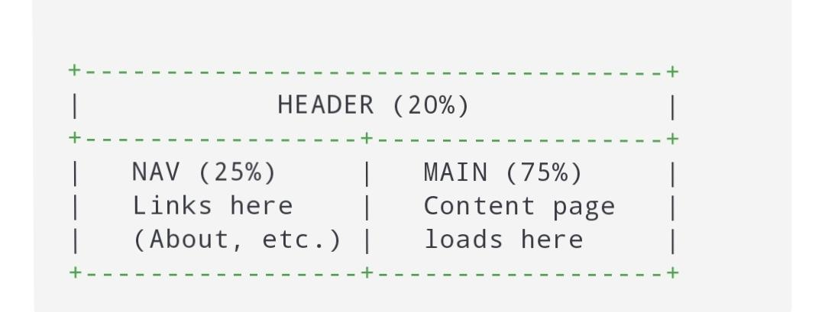
RESULTS AND SCREENSHOTS
The HTML Frames project successfully created a multi-frame webpage layout. The window was divided into a header, navigation panel, and main content area. Navigation links loaded the corresponding pages in the content frame without reloading the whole page. A <noframes> message was also displayed for unsupported browsers.
3/21/2024 Annual Review
10

Slide 11
CONCLUSION
The project demonstrated how HTML frames can divide a webpage into multiple sections for structured navigation and content display. A header, navigation panel, and content area were implemented, allowing smooth browsing within the same window. Although frames are now outdated in modern HTML5, this project provided practical understanding of webpage division, link targeting, and multi-file organization.
11

